Slide 1



ADAPTIVE USER INTERFACES BASED ON AI.
Student: Ivana Gerchakova
Index : 210226
University: Goce Delchev University – Faculty of Computer Science – Robotics and Intelligent Systems
Subject:: Advanced Interactive Technologies
Professor: Prof. Dr. Natasha Koceska
05 June, 2025

Slide 2

PROJECT
OBJECTIVE
👉 Developed a web application that uses the camera to detect emotions (happiness, sadness, neutrality) and automatically adjusts the interface’s appearance and mood.
👉 The adaptation occurs through changes in:
background color
text style
emoji
background music

Slide 3

TECHNOLOGIES AND TOOLS USED
🔹 HTML / CSS / JavaScript – for basic web structure and logic
🔹 face-api.js – for real-time facial emotion recognition
🔹 Webcam API – to access the webcam
🔹 VS Code – as the development environment
🔹 OBS Studio – for demo recording
🔹 CDN and models from GitHub:
👉 https://github.com/justadudewhohacks/face-api.js-models

Slide 4

MAIN APPLICATION COMPONENTS
🧱 HTML (index.html):
Embedded <video> element for the webcam
Display of current emotion
<audio> tag for background music
📜 JavaScript (script.js):
Loading face-api.js models
Face and emotion detection
UI adaptation based on detected emotion
🎨 CSS (style.css):
Styling for each emotion
Smooth transition

Slide 5

EMOTION PROCESSING (JAVASCRIPT LOGIC)
✅ face-api.js is used for:
Face detection with TinyFaceDetector
Emotion recognition with faceExpressionNet
✅ Every 2 seconds:
Facial expressions are read
If the dominant emotion has confidence > 0.7 and at least 8 seconds have passed since the last update:
➡️ The UI is updated (color, text, music)

Slide 6

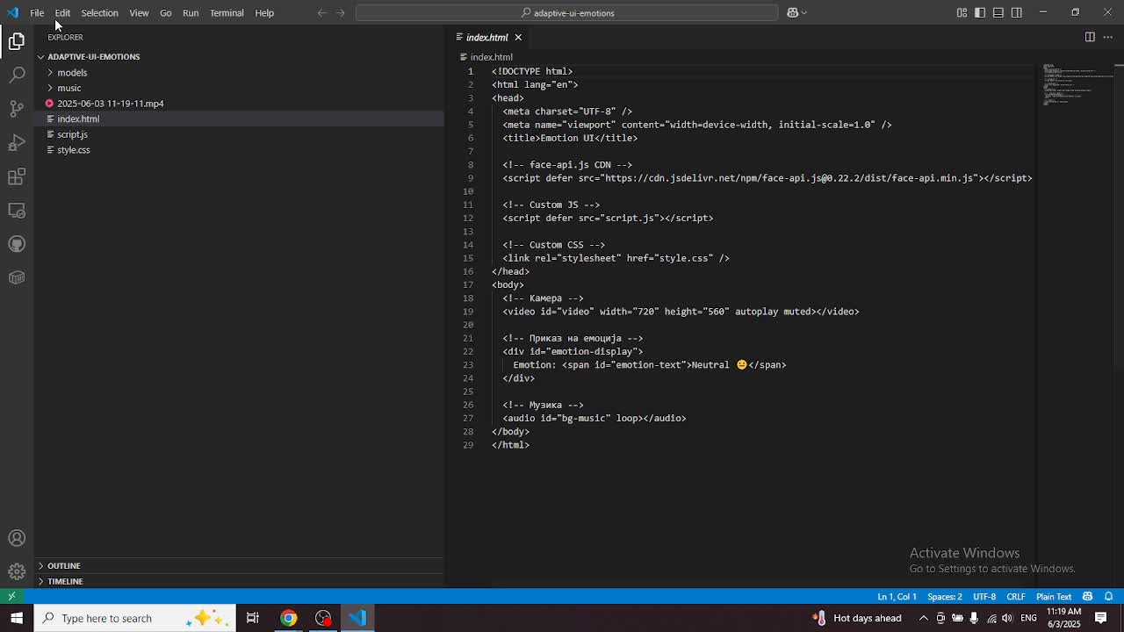
🎥 WATCH THE DEMO VIDEO

Slide 7

THANK YOU FOR YOUR ATTENTION!

